Slide 1

SIMPLE ROUTER
- Aditi Sharma

Slide 2

Introduction
A simple router simulation in Python, simulating a very simple network with a single server and multiple clients. The server shall be sending some data to the router, and the router will have functionality to decide which client to deliver the data to.
This Photo by Unknown author is licensed under CC BY-SA-NC.

Slide 3
Pre-requisites
Some experience working with Python
Basic idea about nodes, clients, and servers. And the fact that there may be several server applications and several client applications on a node.
Some idea about MAC addresses and IP addresses, mainly the fact how your computer has a globally unique MAC address but it’s IP address is dependent on the network it is connected to, currently.

Slide 4

Creating a simple server-client application using Sockets
import socket
connection = socket.socket(socket.AF_INET, socket.SOCK_STREAM)
connection.bind((socket.gethostname(), 8000))
connection.listen(5)
while True:
connectedsocket, address = connection.accept()
print("Connection from {address} established".format(address = address))

Slide 5

Creating a client
import socket
connection = socket.socket(socket.AF_INET, socket.SOCK_STREAM)
connection.connect((socket.gethostname(), 8000))
while True:
message = connection.recv(1024)
This Photo by Unknown author is licensed under CC BY.

Slide 6

Sending and receiving data
import socket
connection = socket.socket(socket.AF_INET, socket.SOCK_STREAM)
connection.bind((socket.gethostname(), 8000))
connection.listen(5)
while True:
connectedsocket, address = connection.accept()
print("Connection from {address} established".format(address = address))
connectedsocket.send(bytes("First message", "utf-8"))

Slide 7
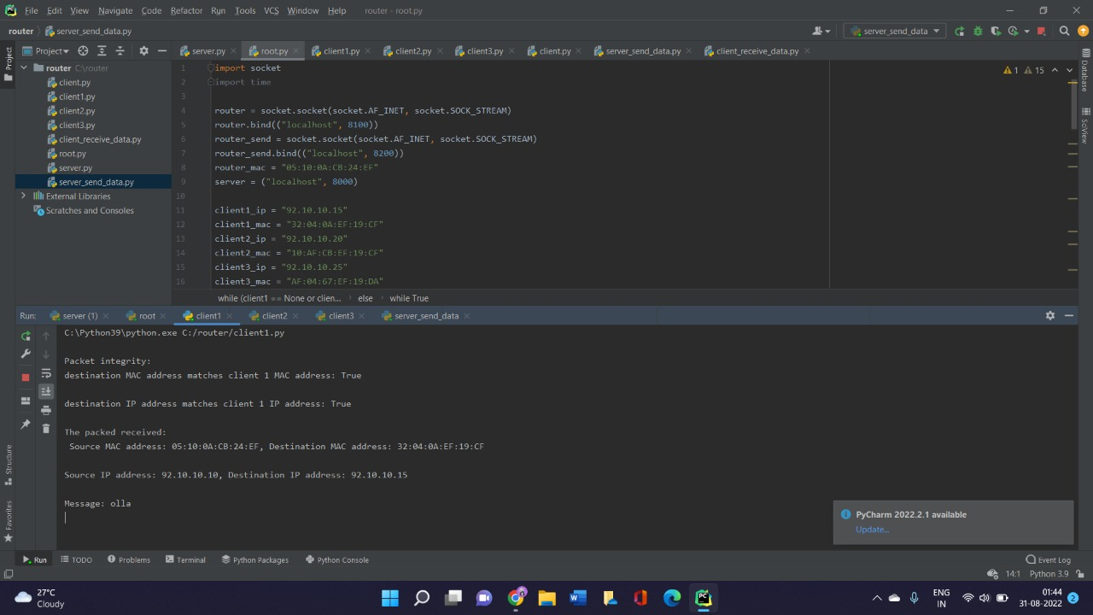
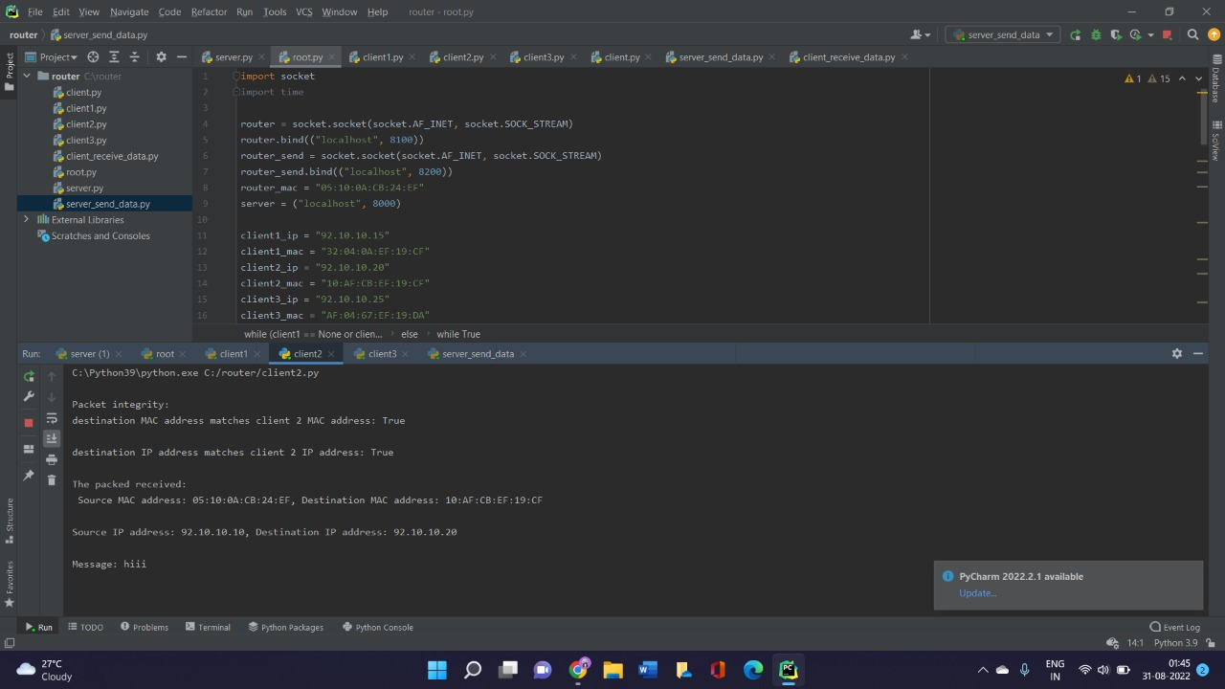
Building a simple router application
Client 1
Client 2

Slide 8
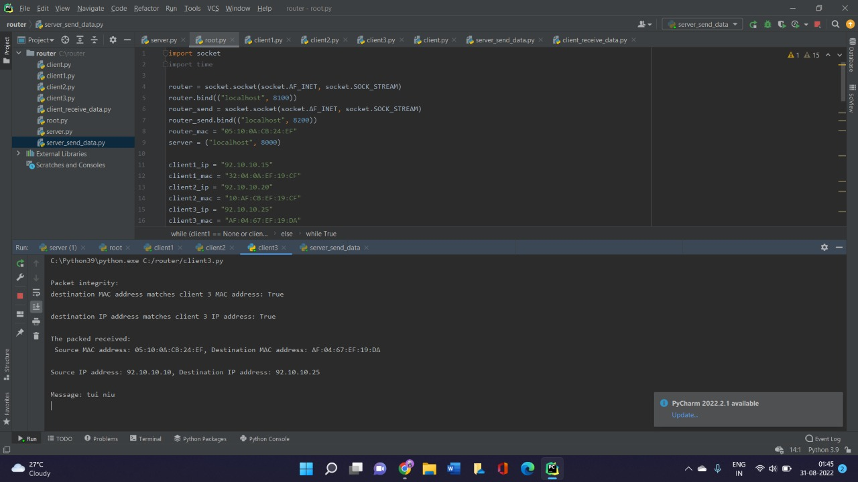
Client 3

Slide 9
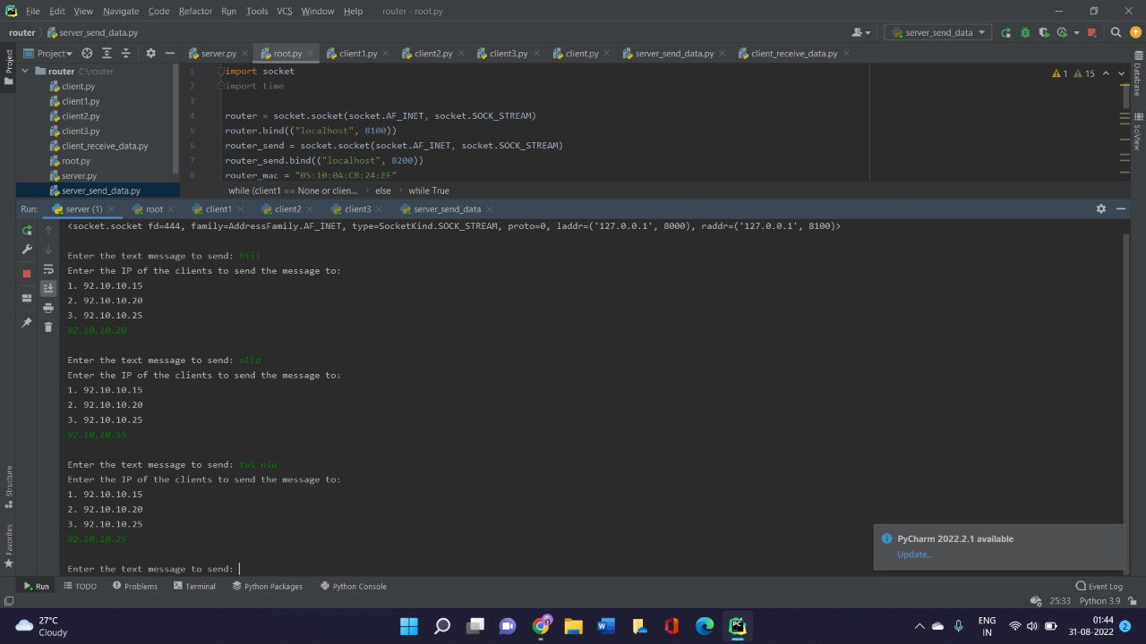
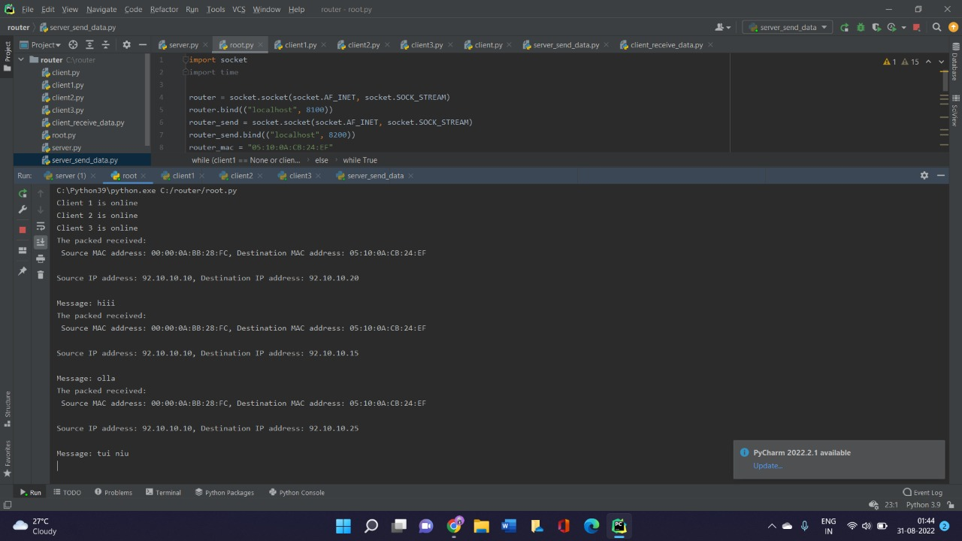
Testing
Server
Router

Slide 10

Thank you
THANK YOU

